Slide 1
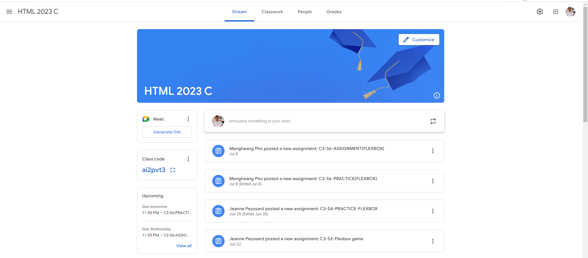
Identify root components of website below

Slide 2
Nav
Flex: 0,
Header
Main
Flex: 0,
Flex: 1,

Slide 3
Navigation
Nav-left
Nav-center
Nav-right

Slide 4
Navigation
icon
text
text
text
text
text
icon
icon
icon

Slide 5
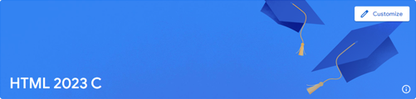
Header
Div 1
Div 2

Slide 6
Header
text
button
icon

Slide 7
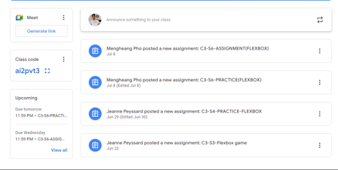
Main

